Slide 1

Enterprise Content Management Concepts & Technologies
Presentation
Jan, 10 2011

Slide 2

What is Content ?
Unstructured content
Does not fit into rows and columns
Types of unstructured content
Documents, Web pages, XML components, audio, video, medical images, scanned images, engineering drawings, enterprise reports, records, presentations, …
Over 80% of enterprise content is unstructured (Fulcrum Research)
Content volume is growing by over 200% per year (Forrester Research)
Unstructured
Structured

Slide 3
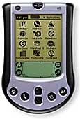

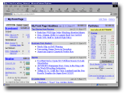
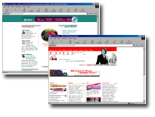
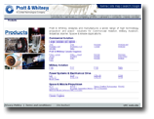

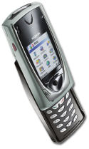


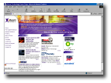


Content is Everywhere
Content
Content
People
Sales Force Automation
Content
Employee Portals
Content
E-Procurement
Records
Content
Customer Sites
Content
Content
Order Fulfillment
Image Library
Content
Content
Manufacturing
Supply Chain Collaboration
E-Marketing
Content
Content
R&D

Slide 4
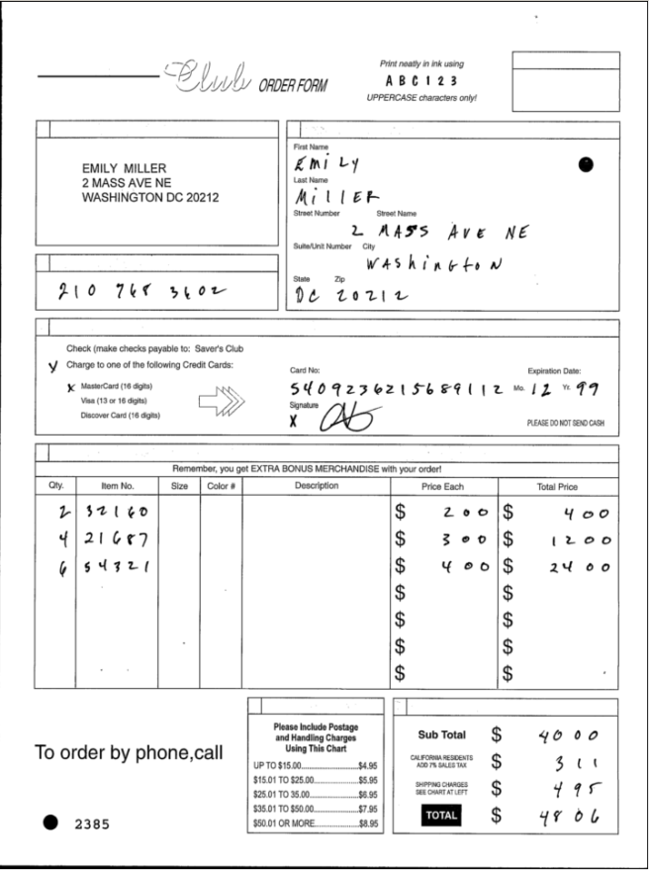
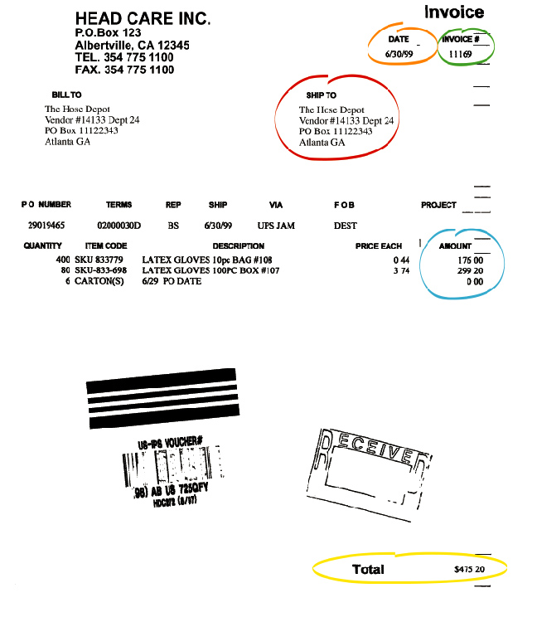
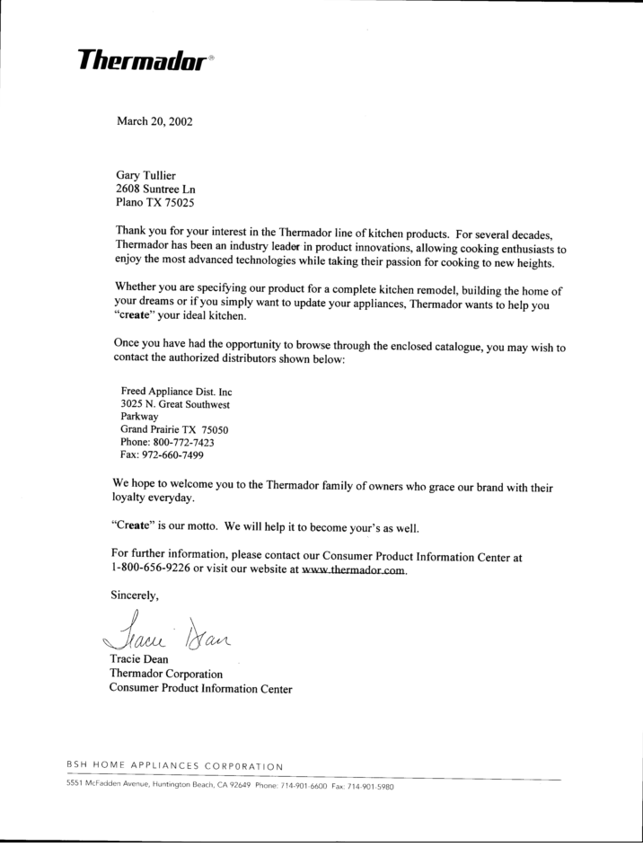
Documents Style
Structured
Semi-Structured
Unstructured
Documents:
We know WHAT
We know WHERE
Documents:
We know WHAT
We do NOT know WHERE
Documents:
We do know WHAT
We know do WHERE

Slide 5
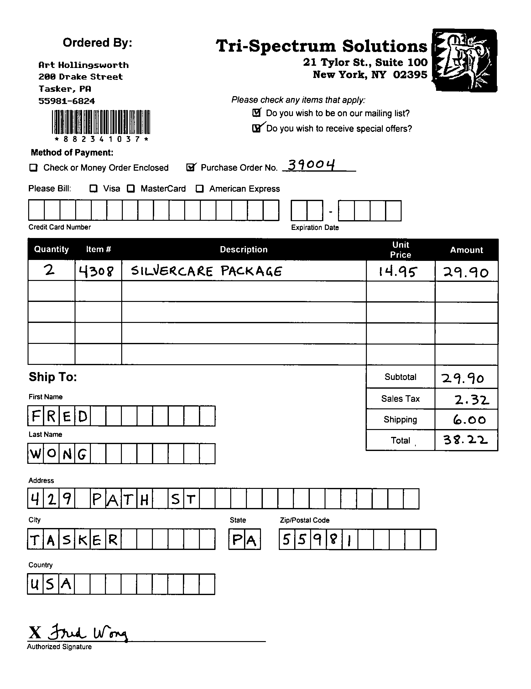
Type of Information
Different information to capture:
Printed Information (OCR)
Barcode
Checkbox (OMR)
Hand Written (ICR)

Slide 6
Why ECM- these are also the truths
Average knowledge worker’s time spent looking for information
40%
70%
How often content is recreated
rather than re-used
Average expense in creating, managing and distributing documents
20%
300%
Potential increase in legal and audit fees due to requirements for corporate governance
Annual rate at which content
volume is growing
200%
25K
The number of emails a knowledge worker receives per year
x5
Average no. of copies made of every document in its life cycle
Sources: Forrester Research, Media Asset Management, Gartner Group Report

Slide 7
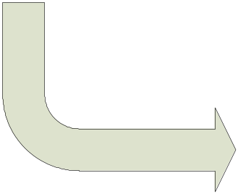

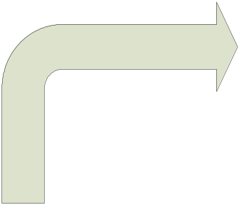
ECM defined…Capture
How do you move content- paper or electronic into content repository for reuse, distribution, and storage
Human Created Information
Office Documents
Forms
Rich Media
Micro Films
Technologies
OCR/ICR/OMR
Document Imagining
Form Processing
e-Forms & Web Forms
Aggregation
COLD/ ERM
Classification
Indexing
Input Design
Categorization
Inputs
Application Created Information
Enterprise Resource
Planning(ERP)
e-Billings
Customer Relationship Management (CRM) & Supply Chain Management(SCM)
Web Content &
XML

Slide 8

ECM defined…Manage
What are the tools & techniques for moving content around an organization and monitoring those tools performance?
Library Services
search
Version Control
Check in/out
Retrieval
Audit trail
Document Management
Web Content Management
Classification
Indexing
Input Design
Categorization
Collaboration
Workflow/BPM
Records Management

Slide 9
ECM defined…Store
Where you put your content and how do you find it again?
Technologies
SAN/NAS
DVD/CD-ROM/Tape
Magnetic Storage/RAID/Optical Disc
Repositories
File System
CM System
Database
Data Warehouses
Library Services
search
Version Control
Check in/out
Retrieval
Audit trail

Slide 10

ECM defined…Deliver
How do you get the right content to the right audience on the right device?
Manage
Layout
Publications
Transformation Technologies
COLD/ERM
XML/PDF
Personalization
Compression
Syndication
Security Technologies
PKI
Digital Rights Management
Digital Signature
Distribution
Paper
Internet/ Extranet/ Intranet
Portal
Email/ Fax
Mobile Devices
Output

Slide 11
ECM Components
Enterprise Content Management & Portal
IMAGING
DOCUMENT MANAGEMENT
BUSINESS PROCESS MANAGEMENT
RECORDS MANAGEMENT
KNOWLEDGE MANAGEMENT
WEB CONTENT MANAGEMENT
DIGITAL ASSET MANAGEMENT
Enterprise Application Integration

Slide 12
Document Imaging
And Document Management
Presentation
Jan, 10 2011

Slide 13
Bringing in Documents
Scanning, for paper files
Conversion, for creating unalterable images of electronic documents E.g.. CAD to TIFF
Importation, for creating modifiable versions of electronic documents , these documents remain in their native format
Fax /email

Slide 14
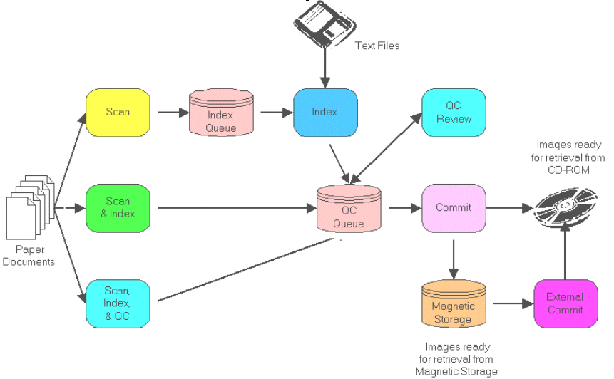
Document Capture

Slide 15

Scanning
Produces a raster image
Choosing a scanner
  Resolution
  Automatic document feeder
  Paper size and volume
  Barcode detection , ICR / OCR
  Speed i.E pages/minute
  Duplex
Outsourcing scanning jobs
Notes:
Scanning a document produces a raster (picture)image that can be stored on a computer. When choosing a scanner, it is important to consider overall budget and the size and volume of paper to be scanned. The ability to use a wide range of scanners is one of the defining characteristics of a good imaging system.
A document imaging scanner should have an Automatic Document Feeder (ADF).This device allows stacks of paper to be placed into a tray and automatically fed one page at a time into the scanner, speeding up the scanning process. Scanners without an ADF are primarily designed for imaging graphics and require each page to be placed manually in the scanner.
Scanners can handle a variety of paper sizes, from business cards to engineering drawings. Most departments only need to scan documents up to legal-size paper (8 1 /2"x 14").For organizations or departments that use blueprints, plans and architectural drawings, there are large-format scanners that support E-sized (34"x 44") documents. In general, the larger the paper-size the scanner can handle, the more expensive it is. Other options ,such as color or grayscale (used for photographs),also increase the scanner ’s price.
The speed of the document scanner is another consideration.Document imaging scanners can handle between 10 –200 pages per minute. These are available in both simplex mode and duplex mode.Duplex scanning allows both sides of a two-sided document to be scanned in a single pass.As with other options,high speed scanning and duplex scanning will increase the price of the scanner.In some instances,it is more economical to purchase two 20-page-per-minute scanners than one 40-page-per-minute scanner.This option is only supported by document imaging systems that support multiple scan stations.
If there is a large volume of documents to scan, i.e.thousands or millions of pages,it may be more practical and economical to use an outside scanning service bureau. To support this option,the imaging system must accommodate easy database synchronization between information scanned by the service bureau and pages scanned in-house.The data volumes containing images and index information need to be modular and easily portable.This ensures that the documents scanned by the service bureau can be incorporated into a “live ”system without interrupting or re-indexing existing work.This option is often referred to as “portable volumes. ”If an organization has several offices and needs to share the documents scanned by each, portable volumes capability provides an easy way to distribute files.

Slide 16
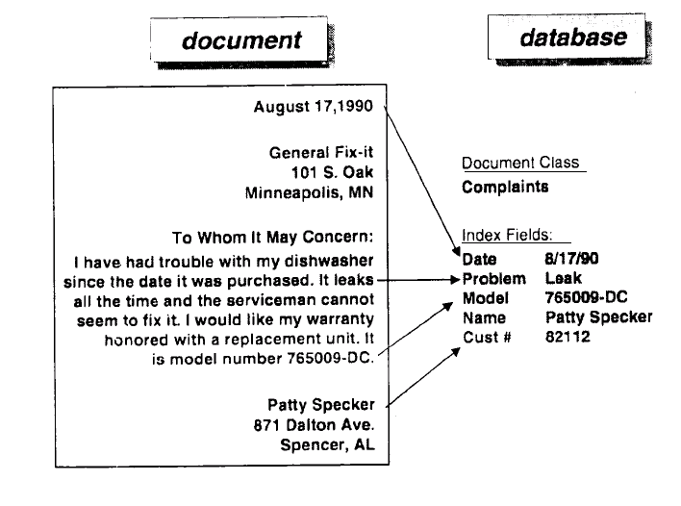
Indexing

Slide 17
Indexing
Add Meta data to document
Categorize / clarify a document
Custom attributes to documents
3 types of indexing
  Index Fields/attributes
  Full Text indexing (OCR or other FTR engines)
  Folder/File Structure
  Auto Indexing using barcodes
Helps in faster retrieval of content
Notes:
Indexing Fields
Indexing documents using categorization fields and keywords is a method traditionally used with paper files that translates very well into electronic systems. An imaging system should allow users to customize index templates, create multiple templates and have different types of index field data within each template, such as date, number and alphanumeric characters. Index fields can be used to categorize documents, track creation or retention dates, or record subject matter, among other uses. In addition, an imaging system should allow pull-down boxes to speed index field entry and have tools available to help automate entering index information.
Full-text Indexing
By providing full-text indexing, imaging systems eliminate the time needed for qualified people to read and manually index documents using keywords. To do this, the software must have the capability to perform Optical Character Recognition (OCR). This process “reads” a scanned page and then indexes every word to track its location. This dramatically reduces indexing costs while providing improved searching capabilities. With full-text indexing, documents can be found using any word or phrase in the document, even if those words are not part of the keyword index. Typically, when a computer OCR’s a document, it uses English as the default alphabet. If multiple languages are required, the imaging system should support OCR and full-text searches in these languages.
To avoid creating extra work, a well designed imaging system should provide the ability to automatically OCR and full-text index a document without requiring any human involvement.
Folder/File Structure
Along with index fields and full-text indexing, an imaging system should provide a visual method of finding documents. In most offices, files are normally found by looking in a particular folder, in a particular drawer, in a particular file cabinet. An imaging system should have the ability to electronically re-create this filing system through multiple levels of nested folders. A flexible folder structure eases the transition from paper filing to electronic filing and makes imaging systems more successful.

Slide 18
Retrieval
Document ID
Index / attribute search
Complex search based on multiple search criteria
Full text search
Folder browse

Slide 19
Full Text Search
Fuzzy Logic
Wildcards to compensate for misspellings or when the spelling is uncertain
Boolean Operators
Proximity Searches
Lines of Context
Notes:
• Fuzzy Logic: Full-text searches assume that the search words have been spelled and OCR’ed correctly. Unfortunately, people misspell words and no OCR package is 100% perfect. “Fuzzy” logic compensates for these errors by searching for variations on the spelling of a word. DMS allows the user to control the amount of “fuzziness” of the search by setting how many letters can be wrong or what percentage of a word can be wrong. For example, a “fuzzy” logic search for “goat” would find “goat,” “gout” and “coat.”
• Wildcards: Wildcards are characters, * (asterisk) and ? (question mark), that can be used in full-text or index keyword searches to compensate for misspellings or when the spelling is uncertain.
• Boolean Operators: Whenever full-text searches are performed, there are usually several documents that meet the search criteria. Boolean operators (AND, OR and NOT) help fine-tune searches reduce the number of unrelated documents.
• Proximity Searches: Proximity searches can also be used to narrow the search results. They are used to find words that occur within a certain number of words, sentences or paragraphs of each other. For example, to find documents relating to tobacco lawsuits, but not smoking ordinances or tobacco growing, users could search for “tobacco” within one sentence of “lawsuit.”
• Lines of Context: Even specific searches usually produce several possible documents. In addition to providing users with a list of documents that meet their search criteria, some systems also display lines of context that show how each occurrence of the search word is used in each document. Lines of context help users find the appropriate document without having to view every document in the search results.
• Highlighted Search Words: Once a document is selected, the search word needs to be located within it. To help with this, some imaging systems display the appropriate page of the document and highlight the search word in both the text and image. This makes it easy for the user to immediately zoom in on the relevant section instead of having to look through multiple pages of a document. The importance of this becomes obvious when the needed word occurs on page 97 in a 200 page document.

Slide 20
View
Display in common viewer capable of viewing multiple file formats
Cross platform viewer
Java Viewers , Web Viewer
Thumbnail view
Native application plug-in

Slide 21
Document Management System
The primary goals of document management:
  Secure document access via check-in/check-out
  Versioning
  Multi-format handling capability
  Archiving
  Presentation
  workflow management.
Notes:
Electronic Document management is the automated control of electronic documents page images, spreadsheets, word processing documents, and complex, compound documents—through their entire life cycle within an organization, from initial creation to final archiving.
Document management allows organizations to exert greater control over the production, storage, and distribution of documents, yielding greater efficiencies in the ability to reuse information, to control a document through a workflow process, and to reduce product cycle times.
The full range of functions that a document management system may perform includes document identification, storage and retrieval, tracking, version control, workflow management, and presentation.
The benefits of document management for businesses include:
leveraging intellectual capital such that knowledge is created once, then reused many times
managing workflow, controlling the flow of information through all phases of a process
fostering more effective teamwork to accelerate business-critical applications
delivering products faster with better customer service (reduce cycle times)
allowing rapid response to events

Slide 22
Business Process Management
Presentation
Jan, 10 2011

Slide 23
What is Workflow …?
Workflow can be described simply as the movement of documents and tasks through a business process.
Workflow is a sequential progression of work activities or a complex set of processes each taking place concurrently, eventually impacting each other according to a set of rules, routes, and roles.
Notes:
Workflow refers to the automation of a business process, in whole or part, during which documents, information or tasks are passed from one participant to another for action, according to a set of procedural rules. The automation of a business process is defined within a Process Definition, which identifies the various process activities, procedural rules and associated control data used to manage the workflow during process enactment. Many individual process instances may be operational during process enactment, each associated with a specific set of data relevant to that individual process instance (or workitem). A loose distinction is sometimes drawn between production workflow, in which most of the procedural rules are defined in advance, and ad-hoc workflow, in which the procedural rules may be modified or created during the operation of the process.

Slide 24
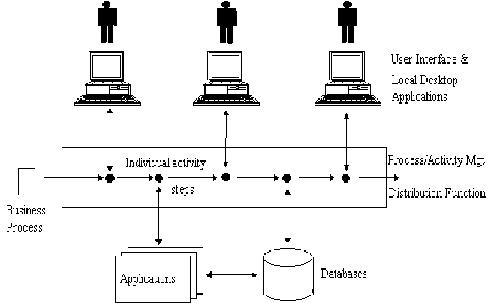
Workflow Management : Putting it all together

Slide 25
Workflow Management System - Goals
Define
Measure
Control
Analyze & Improve
Integrate

Slide 26
Some Typical Workflow Management Features...
Process Definition Tool
Simulation, Prototyping, Piloting
Task Initiation & Control
Rules Based Decision Making
Document Routing
Invocation of Applications
Worklists
Notes:
Process Definition Tool: A graphical or textual tool for defining the business
process. Each activity within the process is associated with a person or a
computer application. Rules are created to determine how the activities
progress across the workflow and which controls are in place to govern each
activity. Some workflow systems allow dynamic changes to the business
process by selected people with administrative clearance.
• Simulation, Prototyping and Piloting: Some systems allow workflow
simulation or create prototype and/or pilot versions of a particular workflow so
that it can be tried and tested on a limited basis before it goes into production.
• Task Initiation & Control: The business process defined above is initiated
and the appropriate human and IT resources are scheduled and/or engaged to
complete each activity as the process progresses.
• Rules Based Decision Making: Rules are created for each step to determine
how workflow-related data is to be processed, routed, tracked, and controlled.
As an example, one rule might generate email notifications when a condition
has been met. Another rule might implement conditional routing of documents
and tasks based on the content of fields. Still another might invoke a particular
application to view data.
• Document Routing: In simple systems, this might be accomplished by
passing a file or folder from one recipient to another (e.g., an email
attachment). In more sophisticated systems, it would be accomplished by
checking the documents in an out of a central repository. Both systems might
allow for redlining of the documents so that each person in the process can add
their own comments without affecting the original document.
• Invocation of Applications to View and Manipulate Data: Word-processors,
spreadsheets, GIS systems, production applications, etc. can be invoked to
allow workers to create, update, and view data and documents.
Worklists: These allow each worker to quickly identify their current tasks
along with such things as due date, goal date, priority, etc. In some systems,
anticipated workload can be displayed as well. These systems analyze where
jobs are in the workflow and how long each step should take, and then estimate
when various tasks will reach an individual’s desk.

Slide 27
…Some Typical WfMS Features
Task Automation
Event Notification
Distribution (Routing) Lists for Messages
Process Monitoring
Tracking, Logging, Measuring
Administration & Security
Web Access
Notes:
Task Automation: Computerized tasks can be automatically invoked. This
might include such things as letter writing, email notices, or execution of
production applications. Task automation often requires customization of the
basic workflow product.
• Event Notification: Staff and/or managers can be notified when certain
milestones occur, when workload increases, etc.
• Distribution (Routing) Lists for Messages/Mail: Distribution lists can be
created for sending ad-hoc messages among the staff.
• Process Monitoring: The system can provide valuable information on current
workload, future workload, bottlenecks (current or potential), turn-around time,
missed deadlines, etc.
• Access to Information over the World Wide Web: Some systems provide
Web interfacing modules in order to provide workflow information to remote
customers, suppliers, collaborators, or staff.
• Tracking and Logging of Activities: Information about each step can be
logged. This might include such things as start and completion times,
person(s) assigned to the task, and key status fields. This information might
later be used to analyze the process or to provide evidence that certain tasks
were in fact completed.
• Administration and Security: A number of functions are usually provided to
identify the participants and their respective privileges as well as to administer
routines associated with any application (e.g., file back-ups, archiving of logs).

Slide 28
Benefits
Organizational Change
Process Change
  Reengineering
  Business Process Improvement
Improved Access to Information
  Build Corporate Knowledge
  Understand History & Current Status of a
Particular Project/Job
Improved Security & Reliability
Notes:
The introduction of workflow management tools should be seen as an opportunity
to improve both the underlying business process and the existing organizational
structure. Many benefits can be accrued if the workflow management system is
implemented as part of a broader business solution.
Opportunities for Organizational Change: Workflow Management Systems can
help agencies and departments achieve the organizational changes necessary to
operate effectively in today’s world. These changes might include the move to a
flatter organizational structure and greater team orientation. Since activity
steps, roles, and rules are built into the system, less intervention should be
needed to manage the business process. In addition, improved communications
provided by notifications, document sharing, and an improved understanding of
the process itself can lead to increased collaboration among team members and/or
across teams and business units. Workflow management systems tend to unify
people with diverse skills into a more cohesive unit.
Workflow definition tools also allow for the separation of IT from workflow
management. This puts the business process immediately and directly under the
control of the people using the system.
Opportunities for Process Change: Since workflow systems force organizations
to examine and define their business processes, it is the ideal time to consider
business process reengineering. In fact, it is essential that an underlying
process be analyzed and improved prior to workflow system implementation in
order to avoid further embedding of bad practices. James Kobielus suggests that
an organization optimize a process with any of three goals in mind: “minimizing
process time, maximizing value-added process content, or maximizing flexibility at
the initial point of customer contact.” He provides some guidelines for achieving
each of these:
To minimize process time
reduce the number of participants in a process
reduce the maximum completion time of each task (automate tasks,notify staff of approaching due dates)
reduce time to transfer work between tasks
reduce maximum queuing time for any one project (prioritize items that have been awaiting action for a long time)
increase the number of tasks running in parallel
• To maximize value added content (i.e. improve the quality of your product or
reduce its price)
apply standard workflow routes, roles, and rules automatically to each new case; deviate from the standard only when certain predefined
thresholds are crossed (exceeds dollar limit) or certain flags are raised
(customer complaint)
provide participants with immediate, on-line access to all information bases
enable continual tracking and notification
eliminate costs associated with paper documentation (scan and index as soon as it enters the workflow)
• To maximize flexibility (i.e. more fully address customer needs) at the initial point of contact
provide multiple access options
capture customer data only once
support distributed transaction processing (“one-stop-shopping” for multiple transactions)
enable ad-hoc flexible work-flow by allowing the first point of contact with the customer to tailor the process to the customer’s needs.
Just as important as reengineering is workflow management’s support for continuous business process improvement. Systems which log information
about how the defined process is actually working in practice provide valuable
insights into areas which might be better tuned. Since business people can define
workflow without IT involvement, there is more likelihood that process changes will
occur.
Improved/Increased Access to Information: Workflow management systems
build corporate knowledge. “Workflow takes the business intelligence that comes
from experience and embeds it …” Process information that may have been
scattered among various staff members is now combined and available to all
employees. This is especially useful to newer employees who may have limited
understanding of a more complex business operation.
“Workflow environments encourage knowledge workers to add greater structure -in
the form of routing lists, receipt notifications, version controls, (and
procedures)...”
Staff are now more likely to provide information to other members
of the team. For any particular project or job, more information about both the
history and the current status of the process is now available for any staff member
to view.
Improved Security & Reliability: Workflow management “provides secure
storage and access to a consistent set of all of the data related to a service.”
Workflow management unites data from many different applications and provides
this data with organization and integrity. Using mechanisms such as role
privileges (determines who can access and/or change information), process
control (e.g. a document may need management approval before moving on to the
next step), version control, and system back-ups, the data becomes more reliable.

Slide 29
Trade-Offs & Dangers
Worker Resistance
Over management
Loss of Flexibility
Costs: Process Definition & System Implementation
Creation of New Work: Managing the
System
Notes:
Trade-Offs
Investments in workflow tools will not solve underlying problems in the business
process if the tool is simply used to automate existing bad processes. In fact,
problems can accelerate as bad processes are hard-wired and flexibility is
removed. Issues to consider before implementing any workflow system include the
following:
Worker Resistance: Human-factor issues represent the greatest obstacle to the
acceptance of workflow applications in more than 50 percent of cases, according
to Thomas Kolopoulos in his book The Workflow Imperative.
Many workers will see workflow management as a mechanism for removing their decision-making
power or will see it as an instrument of downsizing. Others will resent being
monitored and feel that the system is an invasion of their privacy. Still others will
miss the interpersonal give-and-take which might now be replaced by an
automated system.
Overmanagement: Workflow processes can be defined at any level of detail. A
system which attempts to dictate and monitor every detail of the process may be
excessive and incur unnecessary overhead as well as worker resistance.
Loss of Flexibility: Some business processes require workers to remain flexible
and use personal judgment. These are generally not good candidates for
workflow management.
Technical Implementation Costs: Workflow management systems can be
complex, requiring a variety of resources to implement and manage. Cost
considerations include development and maintenance of the network, the purchase price of the workflow software products, application development and
implementation, and customization of the product.
Costs of Defining Complex Processes: The business process itself may be
difficult to define and even more difficult to reengineer. Success depends on
management and staff commitment and can be expected to take a considerable
amount of time. A reliable workflow definition requires a detailed understanding of
the underlying business process.
Creation of New Work: Managing the business aspects of the system as well as
the technical aspects of the system will create additional work which must be offset
by anticipated savings or benefits.

Slide 30
Records Management
Presentation
Jan, 10 2011

Slide 31
What are Records?
Records are non editable documents which do have some legal agreement between two or more parties.
A record is a document or other electronic or physical entity in an organization that serves as evidence of an activity or transaction performed by the organization and that requires retention for some time period.
Record can be a :
Legal Document.
Contracts
Certificates
Accounts Document
Physical Object like file, folder, CD, Video tapes Etc.

Slide 32
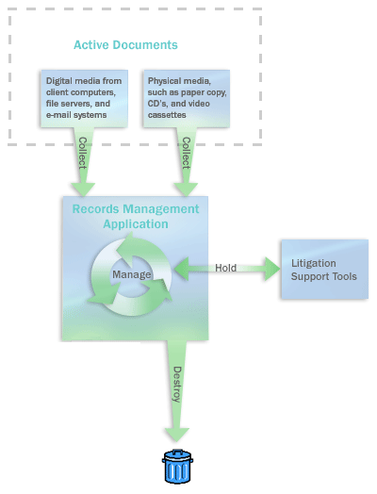
Life Cycle of Records

Slide 33
Life Cycle of Records
Creation: The first phase of the Records Life Cycle involves records being created, collected or received through the daily transactions.
Maintenance & Use: The next phase of the life cycle is the maintenance and use of the record. This can include filing, retrieving, use, duplication, printing, dissemination, release or exchange of the information in the record.
Disposition: At the disposition phase records are assessed to determine their retention value using General Disposal Schedules or Records Disposal Schedules. This leads to either the preservation or destruction of the record.

Slide 34
Life Cycle of Records
Preservation: When a record has been determined to be of permanent value to the Agency and/or Community then it is permanently archived
Temporary Storage & Destruction: If a record still has ongoing value to the Agency it will be temporarily stored either onsite at the Agency or offsite with an Approved Service Provider such as Recall. When the retention date of these records is reached, permission will be sought from the Agency and State Records for their destruction.

Slide 35
Collaboration
Concepts & Technologies
Presentation
August, 10 2009

Slide 36

What is Collaboration?
“Two or more people sharing the complex information on an ongoing basis for a specific goal or purpose”
“Collaboration is the process where a group of people bring together their knowledge and insights to achieve a common goal they cannot achieve by themselves.”
"a Web-based platform that brings together the knowledge, experience and skills of team members to work towards a common goal."
"application suites that include calendaring, email and instant messaging functions which facilitate information-sharing in many forms with suppliers, partners, and customers."

Slide 37
Modes of collaboration
Modes of collaboration
  gossips
  Talking over phone
  email
  Chatting
  Discussion thread
  polling
  Web conferencing
  More…..

Slide 38
Critical Definitions
Synchronous Collaboration- the interaction occurs via computer within 5 seconds (ex: IM/chat)
Asynchronous Collaboration- no time limit on the computer-mediated interaction (ex: threaded discussions, e-mail)

Slide 39
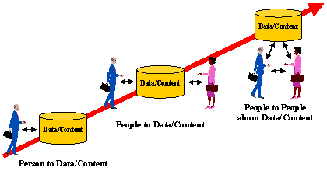
Evolution of Collaboration

Slide 40
Competitors & their products
Documentum: eRoom
IBM: Quickplace & Workplace
Interwoven: iMange
Vignette: intraspect
Microsoft: Sharepoint Portal & Sharepoint services
Oracle: Oracle Collaboration Suite

Slide 41
Benefits of Collaboration
Faster and more effective idea generation, problem-solving, and issue resolution
Higher-quality, lower-cost products, and services with faster delivery cycles
Visibility into the status of critical projects and business processes
Better knowledge-sharing and easier reuse of best practices
High-performance, fast-cycle collaboration on projects of every type

Slide 42
Web Content Management
Concepts & Technologies
Presentation
Jan, 10 2011

Slide 43
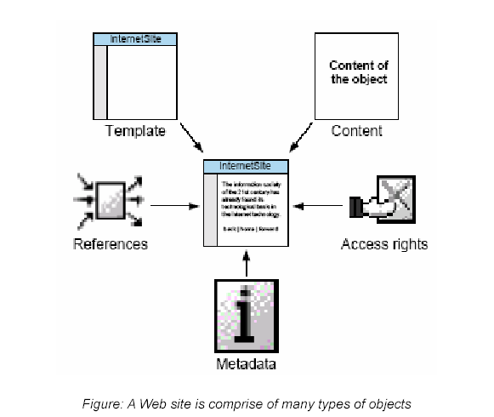
What is Web Content Management
A technology that addresses the content creation, review, approval, and publishing processes of Web-based content ….by AIIM
“Software that enables the collection, assembly, staging, maintenance, monitoring and delivery of textual and graphic content for web”… by Giga research

Slide 44
Why Web Content Management?
Amount of information and functionality on the site is expanding rapidly
Requirements for expanding the site to encompass new areas such as business-to-business relationships, multi-lingual sites, integration with suppliers and partners
Content on the site needs to be more up to date and the process for updating site content needs to be more efficient. For example, the ‘Webmaster bottleneck’ must be overcome.
Expectations for the reliability and quality of site performance are fast increasing: broken links, missing images and invalid e-mail addresses are just not acceptable; page load times must be minimized and consistency of branding and presentation maintained.
Increasing demand for personalized content and functionality
Growing requirements for content to be published not just to other digital channels but offline channels such as print as well.
Notes:
The music industry has been the highest-profile talking point of the digital debate, partly because the visible parts of the business model select, pay for, and download three or four-minute pop songs appear to be so simple. Along with SMS (Short Message Service) , MMS (Multimedia Messaging Service) and email, it is the proverbial killer application, but it is one that has shaken an industry to its core. Not only do the Internet and other interconnected information networks provide unprecedented means to access and share content beyond geographical boundaries and time constraints, they also provide an unprecedented means to discuss it and to share information about what is going on.

Slide 45
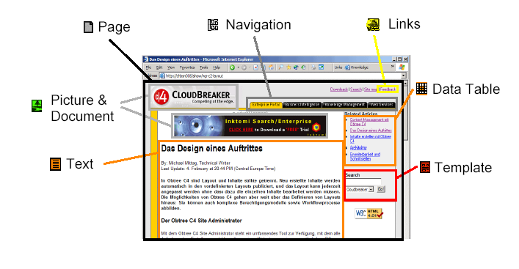
What is Web Content Management System
A software system for authoring, approving and publishing the elements which make up a Web site, without affecting the overall design or structure.
A way of separating presentation from content.
Typical features of a Web CMS include browser-based administration, formatting and layout management, workflow and permission controls, and database integration.

Slide 46
Features of WCM
Control of content authoring
  Simple environment for subject matter experts to develop content – web-based, distributed
  Simple authoring – little or no html or other skills required
  Multi-user; edit mode lock/unlock – prevent “clashing” of changes
  Collaboration (multiple contributors to a single end product)
  Editing of live content without disturbing live presentation
Web Publishing (Control of Content Publishing-Template Authoring)
  Access rights management (approve, publish, etc.)
  Security is critical; no publishing without required approval
  Ability to define, customize approvals workflow
  Ability to pre-publish (view content in target environment)
  Ability to schedule content for future publication (staging)
Site Management

Slide 47











Web Content Management Checklist
Create
Powerful Authoring Tools
Manage
Process, Site & Content Types
Deliver
Publish to Many & Archive
Enterprise Platform
☑ Content Templates
☑ Library Services
☑ Application Templates
☑ Workflow, Lifecycles, Web Annotations
☑ Application Templates
☑ Renditions/Transform
Email
Paper
Portals
☑ Content Templates
☑ Categorizations
☑ Portlet Contribution
☑ Change Sets & Links
Fax
Wireless
CD-Rom
☑ WYSIWYG Editor
☑ Digit Asset Management
☑ Site Caching
☑ In-Context Editing
☑ Content Intelligence
☑ Site Deployment
☑ Graphic & Dev Tools
☑ XML Management
☑ Portal Integration
☑ Associate Rules
☑ Site Mgmt & Analytics
☑ Records Management
☑ User Management
☑ Personalization
☑ Globalization
☑ Customization
☑ Enterprise Infrastructure

Slide 48
Roles in WCM
Content Authors
  Edit content
  Upload images & files
Site Coordinators
  Do all that a content author can do
  Add & delete pages, images & files
  Reuse content
  Set page names & web paths
  Approve pages & make them live
Site Administrator
  Do all that a site coordinator can do
  Build the site
  Set permissions
  Set workflow
  Make Site Live
  Acts as a backup to Site Coordinators
Systems Administrator
  Do all that a site administrator can do
  Acts as a backup to Site Administrator

Slide 49
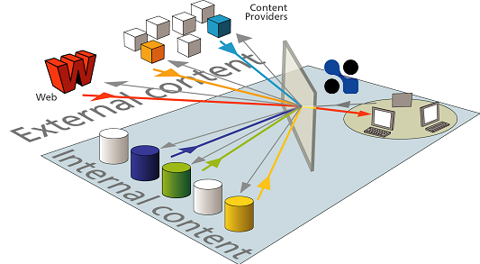
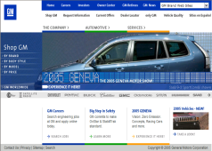

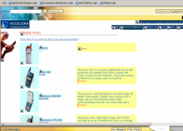



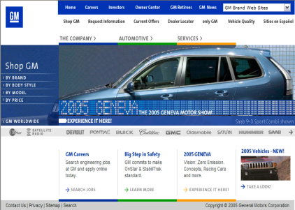




The Publishing Process!
Site Administrator
Demote
Submit
Approve
Content Authors
Site Coordinator
Demote
Create/Connect
Manage
Deliver
Archive
Work In Progress
Staging
Approved
Active
Expired

Slide 50
Competitors & their products
Documentum: Web Content management 5.3
FatWire Software: Content Server 6.0
Interwoven: Teamsite 6.5 and Livesite 2.0
Stellent: Web Content Management 7.2
Micorsoft: Content management Server 2002
Vignette: Content management 7.3
IBM: Workplace Web Content management

Slide 51
Benefits
Anytime, anywhere Web publishing: content "owners“ in your organization can securely add or update content from any Web browser.
Ensures a consistent navigational interface (user experience)
Enables a collaborative workflow for content (create, review, approve)
Eases updatability of site (single revision appears many places)
Efficient workflow management: WCM manages content workflow, handling contributed content and notifying approvers via email that it's ready for review and publishing.
Save time and money: WCM solutions make your organization more efficient and cost-effective by enabling the right person to manage the right content at the right time.

Slide 52
What Benefits does ECM Provides ?
Improved Operational Efficiency & Productivity
  Eliminate content silos, re-work, and duplication
  Better, faster decision-making
  Integrate views of information and data
Increased Knowledge Management
  Content integrity, leverage and re-use
  Secure access to right information
  Leverage content across departments, functions, initiatives
Decreased Compliance Risk and Associated Costs
  Controls and audit trails for enterprise records
  Cost-effective retrieval and access
Leverage Content Infrastructure
  Across multiple applications
  Across many content types
  Across all departments

Slide 53
Major ECM players
2003
2003 Market
2002
2002
Growth
Company
Revenue
Share (%)
Revenue
Market
(%)
Share (%)
YoY
IBM
183.5
17.9
169.4
18.0
8.3
FileNet
119.4
11.6
106.0
11.3
12.6
Documentum/EMC
111.4
10.8
89.0
9.5
25.2
OpenText
80.0
7.8
68.3
7.3
17.2
Interwoven/iManage
62.7
6.1
77.6
8.3
-
19.3
Hummingbird
58.1
5.7
48.1
5.1
21.0
Others
411.8
40.1
381.7
40.6
7.9
Total:
1,026.9
100.0
940.1
100.0
9.2

Slide 54
Thanks
Questions?

